Slide 1
Airline Industry Executive Summary
David Berberena
Bellevue University
DSC 640 Data Presentation and Visualization
Catherine Williams
June 30, 2024

Slide 2
The Media’s Stance on Airline Safety
In light of recent major airline accidents, the media is attempting to impact the airline industry negatively by publishing data that paints a picture of unsafe travel.
The data found on reputable sources shows otherwise, and that will be shown here to emphasize the safety and security the airline industry works hard to maintain.

Slide 3
Internal Review
After performing a visualization analysis of the data, it can be shown that the media has told a malicious story that does not hold a candle to the real information about the airline industry’s safety metrics.
These visualizations will be described at length to assert the airline industry’s positive impact on safety through the years and that our guests are in good hands.

Slide 4
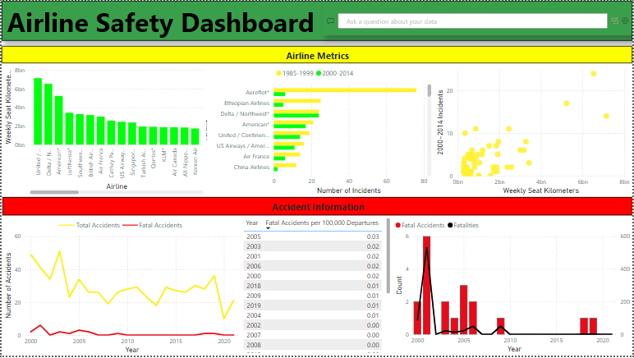
Visualization Analysis
The dashboard that explains the state of the airline industry’s safety throughout is shown here. The color scheme chosen best mimics a traffic light, one of the most well-known safety symbols in the United States of America.

Slide 5
The Color Key
Green in the dashboard is used to showcase areas of safety improvement for shareholders to read and understand easily.
Yellow denotes areas of caution, as there are safety issues that the airline industry as a whole should look to improve upon.
Red indicates a major issue that must be immediately focused on and rectified, as these statistics are a potential detriment to the industry.

Slide 6
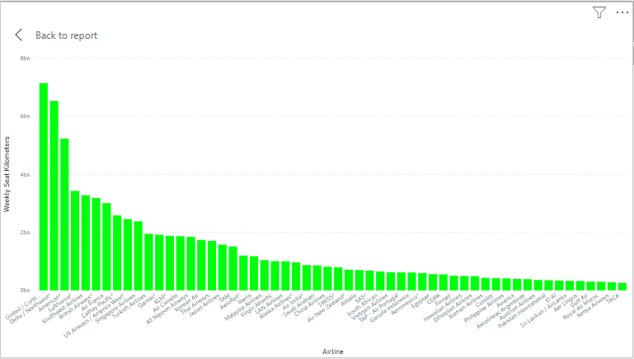
Green: Weekly Seat Kilometers by Airline
This bar chart shows how far each airline flies in seat kilometers on a weekly average, highlighting the airline industry’s overall performance.

Slide 7
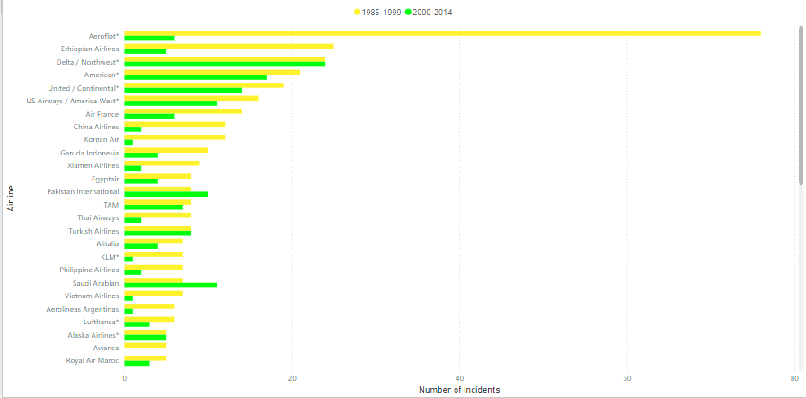
Green/Yellow: Incidents by Airline and Time Period
The horizontal bar chart shows direct progress relating to safety in the airline industry by looking at incident numbers over time.

Slide 8
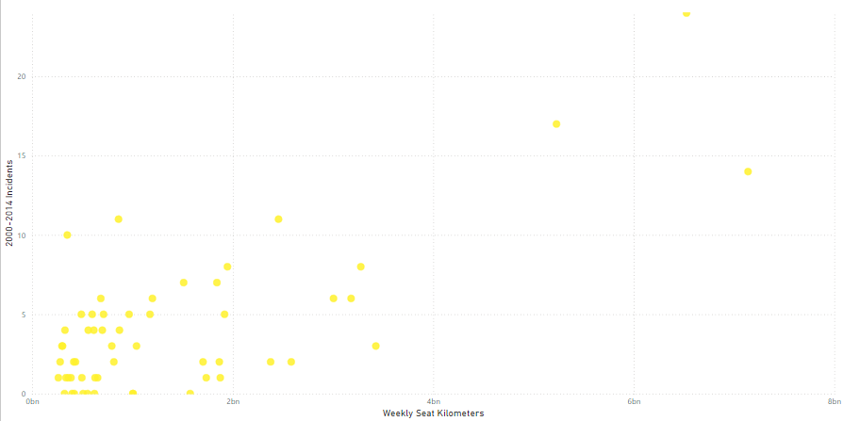
Yellow: 2000-2014 Incident Count Relative to Weekly Seat Kilometers
The scatter plot shown compares the number of incidents from the year ranging 2000-2014 to the weekly seat kilometer count. As incidents are indicators of poor safety, we should observe this more closely.

Slide 9
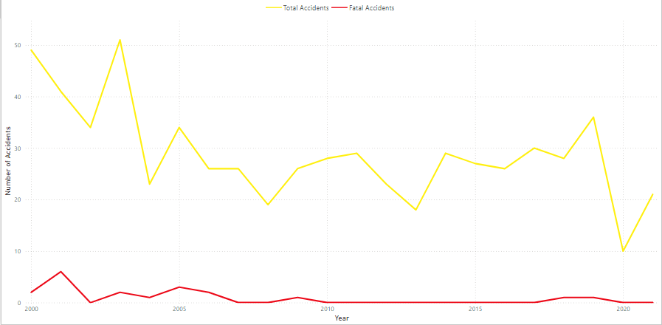
Red: Accidents Over Time by Accident Type
This double-line chart outlines the presence of both non-fatal and fatal accidents from 2000 to 2021. Accidents are sometimes inevitable, yet they always require attention to be paid to them.

Slide 10
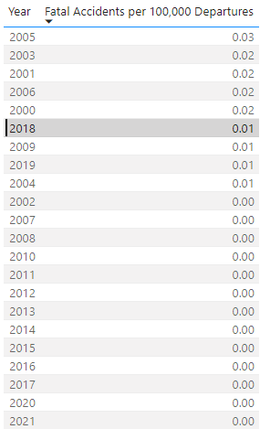
Red: Fatal Accidents per 100,000 Departures by Year (Ordered by Value)
The matrix here shows the years from 2000 to 2021 where the fatal accidents metric was highest per 100,000 flight departures. While the visual aid shows progress, this still is an ongoing shortfall to minimize as much as possible.

Slide 11
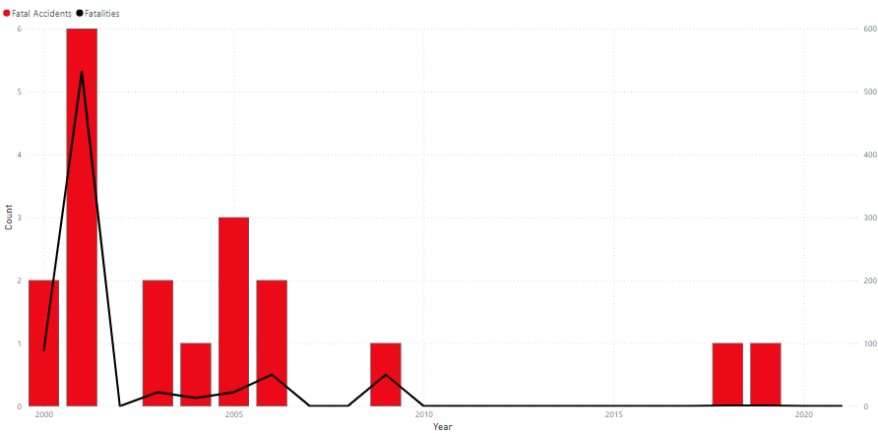
Red: Fatal Occurrence Count Comparison from 2000-2021
Deaths in the airline should never be ignored, as there is always room for improvement to safely bring our guests to and from their desired destinations. Detailing both fatalities and fatal accidents in this visual shows how far the airline industry still has to go regarding safety.

Slide 12
Analysis Findings
With the data from reputable sources having been analyzed, we can confirm a few major discoveries:
Almost every large airline company has improved their safety incident occurrences from the end of the 20th century to the 2010s.
Total accidents, fatal accidents, and fatalities are trending downward, and have been for the last twenty years.
The 2010s decade showed the lowest consistent fatal accident rate per 100,000 departures.

Slide 13
What to Tell Our Shareholders
With our findings laid out, the visualization analysis has told us that the airline industry is not only still strong, safe, and secure, but more so than at any other time in the last 40 years.
The media did not tell the whole story, so while there are still safety metrics that can be lowered, the data shows that safety incidents are trending downward.
Some airlines are at risk of backlash (Aeroflot, United, Delta, American) and should immediately consult their safety board to restructure their company safety policies and plans to realize positive future results.

Slide 14
References
Silver, N. (2014, July 18). Should Travelers Avoid Flying Airlines That Have Had Crashes in the Past? FiveThirtyEight. Retrieved June 15, 2024, from https://fivethirtyeight.com/features/should-travelers-avoid-flying-airlines-that-have-had-crashes-in-the-past/
Airlines for America (2022, December 24). Safety Record of U.S. Air Carriers. Data & Statistics. Retrieved June 15, 2024, from https://www.airlines.org/dataset/safety-record-of-u-s-air-carriers/
Boice, J. (2022, December 16). Airline-safety.csv. Fivethirtyeight. Retrieved June 15, 2024, from https://github.com/fivethirtyeight/data/blob/master/airline-safety/airline-safety.csv

